Slide 1
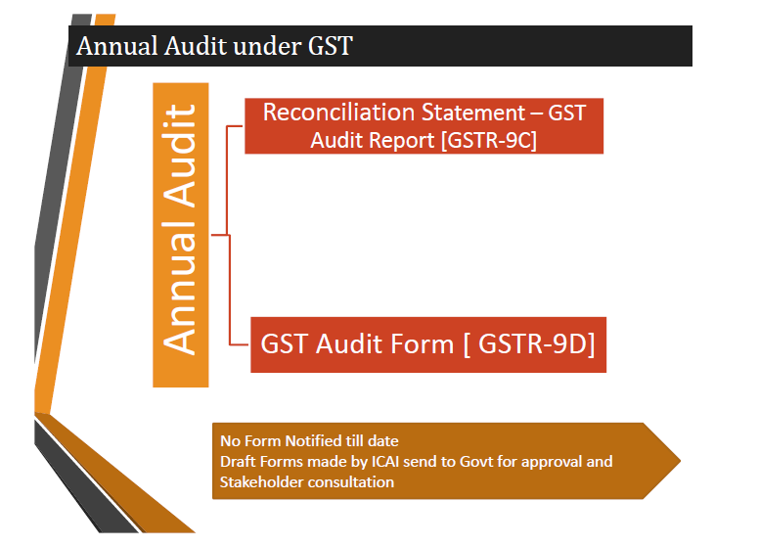
Part A - Reconciliation
GSTR 9C
Part B -Certification

Slide 2


Relevant Provisions- Section35(5)
Every registered person whose turnover during a financial year exceeds the prescribed limit, shall get his accounts audited by a Chartered Accountant or a Cost Accountant and shall submit:
(i) A copy of the audited annual accounts;
(ii) The reconciliation statement under
sub- section(2) of section 44; and
(iii) Such other documents,
in such form and manner as may be prescribed.
2

Slide 3
Relevant Provisions- Section 44(2):
Every registered person who is required to get his accounts audited in accordance with the provisions of sub-section (5) of section 35 shall furnish, electronically, the annual return under sub-section (1) along with a copy of the audited annual accounts and a reconciliation statement, reconciling the value of supplies declared in the return furnished for the financial year with the audited annual financial statement, and such other particulars as may be prescribed.
2

Slide 4

Relevant Provisions- Rule 80(3)
Every registered person whose aggregate turnover during a financial year exceeds two crore rupees shall get his accounts audited as specified under sub- section (5) of section 35 and shall furnish a copy of audited annual accounts and a reconciliation statement, duly certified, in FORM GSTR-9C, electronically through the common portal either directly or through a Facilitation Centre notified by the Commissioner.
2

Slide 5

Sec. 2(6) of the CGST Act: Aggregate Turnover
“Aggregate Turnover” means the aggregate value of :
All taxable supplies (excluding the value of inward supplies on which tax is payable by a person on RCM);
Exempt supplies;
Exports of goods or services or both; and
Inter-State supplies of goods or services or both;
but excludes Central Tax, State tax, Union territory tax, integrated tax and cess.

Slide 6
Sec. 2(112) of the CGST Act: Turnover in State
“Turnover in State” means the aggregate value of :
All taxable supplies (excluding the value of inward supplies on which tax is payable by a person on RCM) made within a State by a TP;
Exempt supplies made within a State by a TP;
Exports of goods or services or both; and
Inter-State supplies of goods or services or both made from the State by the said TP;
but excludes Central Tax, State tax, Union territory tax, integrated tax and cess.

Slide 7
Clarifications regarding Annual Returns and Reconciliation Statement.
Press Release
dt. 3rd July, 2019
(i) Turnover for eligibility of filing of reconciliation statement:
It may be noted that the aggregate turnover i.e. the turnover of all the registrations having the same Permanent Account Number is to be used for determining the requirement of filing of reconciliation statement. Therefore, if there are two registrations in two different States on the same PAN, say State A (with turnover of Rs.1.2 Cr.) and State B (with turnover of Rs.1 Cr.) they are both required to file reconciliation statements individually for their registrations since their aggregate turnover is greater than Rs.2 Cr. The aggregate turnover for this purpose shall be reckoned for the period July, 2017 to March, 2018.
2

Slide 8
Clarifications regarding Annual Returns and Reconciliation Statement.
Press Release
dt. 3rd July, 2019
(h) Role of Chartered Accountant in certifying reconciliation statement:
There are apprehensions that the Chartered Accountant may go beyond the books of account in their recommendations under FORM GSTR-9C. The GST Act is clear in this regard.
With respect to the reconciliation statement, their role is limited to reconciling the values declared in annual return (FORM GSTR-9) with the audited annual accounts of the taxpayer.
2

Slide 9
Clarifications regarding Annual Returns and Reconciliation Statement.
Press Release
dt. 4th Jun, 2019
(h) Payments made through FORM DRC-03:
Payments made through FORM DRC-03 for any supplies relating to period between July 2017 to March 2018 will not be accounted for in FORM GSTR-9 but shall be reported during reconciliation in FORM GSTR-9C.
2

Slide 10
Removal of difficulty order No. 02/2018-CT
Order no. 02/2018-ct
dt. 31st dec, 2018
(2) New Proviso in Sec. 16(4) - Time limit for ITC.
“Provided that the registered person shall be entitled to take input tax credit after the due date of furnishing of the return under section 39 for the month of September, 2018 till the due date of furnishing of the return under the said section for the month of March, 2019 in respect of any invoice or invoice relating to such debit note for supply of goods or services or both made during the financial year 2017-18, the details of which have been uploaded by the supplier under sub-section (1) of section 37 till the due date for furnishing the details under sub-section (1) of said section for the month of March, 2019.”.
2

Slide 11
Removal of difficulty order No. 02/2018-CT
Order no. 02/2018-ct
dt. 31st dec, 2018
(3) New Proviso in Sec. 37(3) - Rectification thru GSTR-1.
“Provided further that the rectification of error or omission in respect of the details furnished under sub-section (1) shall be allowed after furnishing of the return under section 39 for the month of September, 2018 till the due date for furnishing the details under subsection (1) for the month of March, 2019 or for the quarter January, 2019 to March, 2019.”
No time extension for Credit / Debit Notes since the same comes under Sec. 34 which is not covered in this Order.
2

Slide 12
GSTR 9C – OVER VIEW OF STRUCTURE
PART – A - RECONCILIATION STATEMENT
PART – B- CERTIFICATION
Part I- Basic Details
Where reconciliation is drawn up by the person who had conducted the audit;
Where reconciliation is drawn up by a person other than the person who had conducted the audit.
Part II- Reconciliation of Turnover
Part III- Reconciliation of Tax paid
Part IV- Reconciliation of Net Input Tax Credit (ITC)
Part V-Auditor's recommendation on Additional Liability due to non-reconciliation.

Slide 13
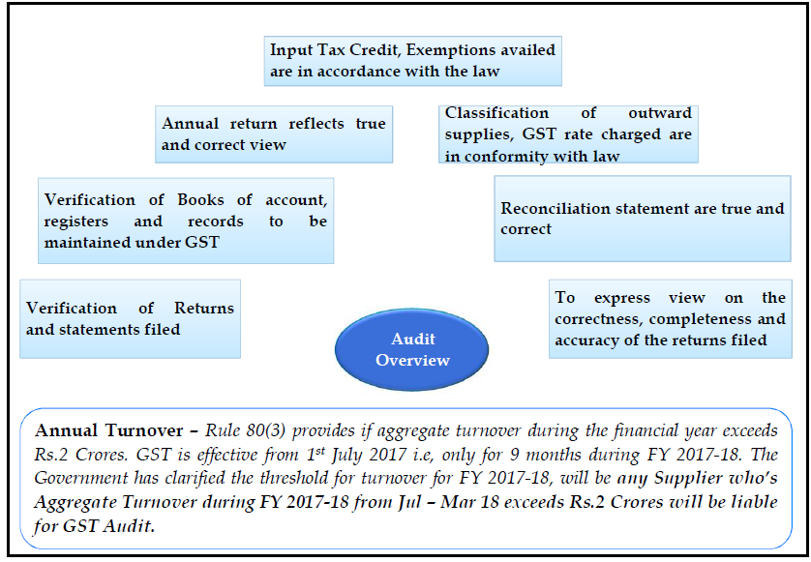

Slide 14
GSTR 9C – RECONCILIATION Overview
PARTS
Part I
Part II
Part III
Part IV
Part V
Basic Details
Table 1-4
Recon
Gross T/O
Table 5-6
Recon Tax paid
Table 9-11
Recon Net ITC
Table 12 -16
Auditor’S Recommen-
dation on Additional Liability due to non-reconcilaton.
Recon
Taxble T/O
Table 7-8

Slide 15
FORM GSTR-9C
See rule 80(3) PART – A - Reconciliation Statement
The details for the period between July 2017 to March 2018 are to be provided in this statement for the financial year 2017-18. The reconciliation statement is to be filed for every GSTIN separately.

Slide 16
HIGHLIGHTS IN PART II - TABLE 5
HIGHLIGHTS
(1) Unbilled Revenue – Opening and Closing ;
(2) Unadjusted Advance – Opening and Closing;
(3) Deemed Supply – Schedule I transactions – Inter unit supplies;
(4) Financial Credit and Debit Notes – Only in Financial Statements;
(5) Valuation differences – Transaction value u/s. 15;
(6) Foreign Exchange Fluctuations – Differential treatment;
(7) Sale of Assets – Accounting method variation;
(8) Out of Pocket expense reimbursement & other income.
2

Slide 17
Reconciliation of gross turnover in AFS with GSTR 9
(Amount in ₹ in all tables)
Part II | Reconciliation of turnover declared in audited Annual Financial Statement with turnover declared in Annual Return GSTR9
5 | Reconciliation of Gross Turnover
A | Turnover (including exports) as per audited financial statements for the State / UT (For multi-GSTIN units under same PAN the turnover shall be derived from the audited Annual Financial Statement)
 | The turnover as per the audited Annual Financial Statement shall be declared here. There may be cases where multiple GSTINs (State-wise registrations) exist on the same PAN. This is common for persons / entities with presence over multiple States. Such persons / entities, will have to internally derive their GSTIN wise turnover and declare the same here. This shall include export turnover (if any). It may be noted that reference to audited Annual Financial Statement includes reference to books of accounts in case of persons / entities having presence over multiple States.
Certificate from auditor;
Management representation;
What if totals do not add up?

Slide 18
Reconciliation of gross turnover in AFS with GSTR 9
(Amount in ₹ in all tables)
B | Unbilled revenue at the beginning of Financial Year | (+)
 | Unbilled revenue which was recorded in the books of accounts on the basis of accrual system of accounting in the last financial year and was carried forward to the current financial year shall be declared here. In other words, when GST is payable during the financial year on such revenue (which was recognized earlier), the value of such revenue shall be declared here. (For example, if rupees Ten Crores of unbilled revenue existed for the financial year 2016-17, and during the current financial year, GST was paid on rupees Four Crores of such revenue, then value of rupees Four Crores rupees shall be declared here)
C | Unadjusted advances at the end of the Financial Year | (+)
 | Value of all advances for which GST has been paid but the same has not been recognized as revenue in the audited Annual Financial Statement shall be declared here.
D | Deemed Supply under Schedule I | (+)
 | Aggregate value of deemed supplies under Schedule I of the CGST Act, 2017 shall be declared here. Any deemed supply which is already part of the turnover in the audited Annual Financial Statement is not required to be included here.
Rental income;
Landline charges;
Services to be invoiced in next month.
Transfer of assets, where ITC is taken;
Supply between related/distinct persons, employees, stock transfers;
Agents and Principal transfers;
Service import from a related person.

Slide 19
Reconciliation of gross turnover in AFS with GSTR 9
Credit notes issued after financial year but included in table 9B of GSTR 1, relating to invoices issued during the financial year;
Transactional Entry wrongly posted in the Books, return filed and mistake noted in the next year;
Book is correct, Return is wrong and this error is noticed next year;
Books and Return are correct, additional knowledge calling for adjustment.
E | Credit Notes issued after the end of the financial year but reflected in the annual return | (-)
 | Aggregate value of credit notes which were issued after 31st of March for any supply accounted in the current financial year but such credit notes were reflected in the annual return (GSTR-9)shall be declared here
F | Trade Discounts accounted for in the audited Annual Financial Statement but are not permissible under GST | (+)
 | Trade discounts which are accounted for in the audited Annual Financial Statement but on which GST was leviable (being not permissible) shall be declared here.
G | Turnover from April 2017 to June 2017 | (-)
 | Turnover included in the audited Annual Financial Statement for April 2017 to June 2017 shall be declared here.

Slide 20
Reconciliation of gross turnover in AFS with GSTR 9
(Amount in ₹ in all tables)
H | Unbilled revenue at the end of Financial Year | (-)
 | Unbilled revenue which was recorded in the books of accounts on the basis of accrual system of accounting during the current financial year but GST was not payable on such revenue in the same financial year shall be declared here.
I | Unadjusted Advances at the beginning of the Financial Year | (-)
 | Value of all advances for which GST has not been paid but the same has been recognized as revenue in the audited Annual Financial Statement shall be declared here
J | Credit notes accounted for in the audited Annual Financial Statement but are not permissible under GST | (+)
 | Aggregate value of credit notes which have been accounted for in the audited Annual Financial Statement but were not admissible under Section 34 of the CGST Act shall be declared here.

Slide 21
Reconciliation of gross turnover in AFS with GSTR 9
K | Adjustments on account of supply of goods by SEZ units to DTA Units | (-)
 | Aggregate value of all goods supplied by SEZs to DTA units for which the DTA units have filed bill of entry shall be declared here.
L | Turnover for the period under composition scheme | (-)
 | There may be cases where registered persons might have opted out of the composition scheme during the current financial year. Their turnover as per the audited Annual Financial Statement would include turnover both as composition taxpayer as well as normal taxpayer. Therefore, the turnover for which GST was paid under the composition scheme shall be declared here.
M | Adjustments in turnover under section 15 and rules thereunder | (+/-)
 | There may be cases where the taxable value and the invoice value differ due to valuation principles under section 15 of the CGST Act, 2017 and rules thereunder. Therefore, any difference between the turnover reported in the Annual Return (GSTR 9) and turnover reported in the audited Annual Financial Statement due to difference in valuation of supplies shall be declared here.
Construction contracts where materials are supplied by awarder, though contractor is responsible;
Incidental charges like transportation not accounted as income;
Valuation rules adjustments.

Slide 22
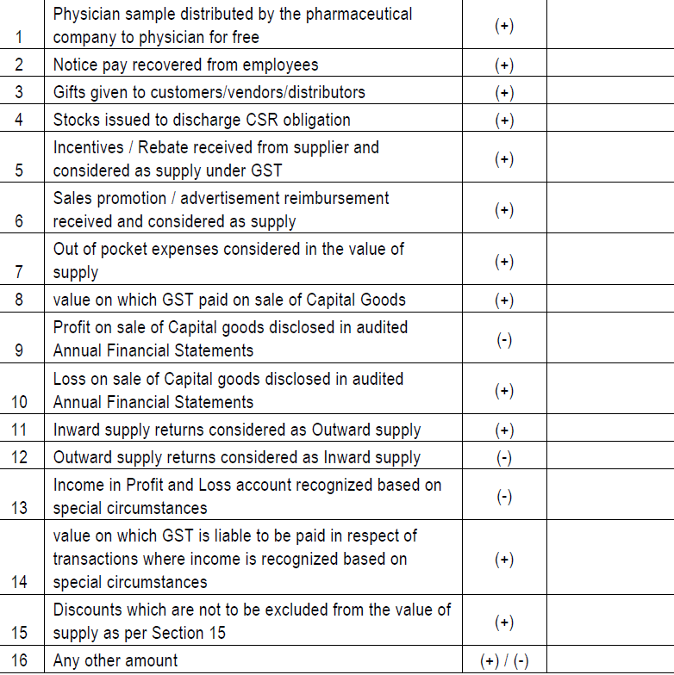
Reconciliation of gross turnover in AFS with GSTR 9
2 types; one at the time of supply; other at the time of realisation of proceeds
N | Adjustments in turnover due to foreign exchange fluctuations | (+/-)
 | Any difference between the turnover reported in the Annual Return (GSTR9) and turnover reported in the audited Annual Financial Statement due to foreign exchange fluctuations shall be declared here.
O | Adjustments in turnover due to reasons not listed above | (+/-)
 | Any difference between the turnover reported in the Annual Return (GSTR9) and turnover reported in the audited Annual Financial Statement due to reasons not listed above shall be declared here.
P | Annual turnover after adjustments as above | <Auto>
Q | Turnover as declared in Annual Return (GSTR9)
 | Annual turnover as declared in the Annual Return (GSTR 9) shall be declared here. This turnover may be derived from Sr. No. 5N, 10 and 11 of Annual Return (GSTR 9).
R | Un-Reconciled turnover (Q - P) | AT1
The turnover arrived at Sl.No.5P shall comprise of the following:
(a) Taxable turnover of outward supply of goods and / or services;
(b) Exempt turnover of outward supply of goods and / or services;
(c) Non-GST outward supplies turnover;
(d) Exports of goods and / or services turnover;
(e) Outward supplies liable to GST under reverse charge mechanism.

Slide 23
Reconciliation of gross turnover in AFS with GSTR 9
6 | Reasons for Un - Reconciled difference in Annual Gross Turnover
A | Reason 1 | <<Text>>
B | Reason 1 | <<Text>>
C | Reason 1 | <<Text>>
Amounts shown in financials, but
(a) Sales omitted in return;
(b) Fixed asset sales not shown in return;
(c) Turnover excess reported in return
(d) Duplication in turnover reported in return

Slide 24
GST.GOV.IN
OFF LINE TOOL SCREEN

Slide 25
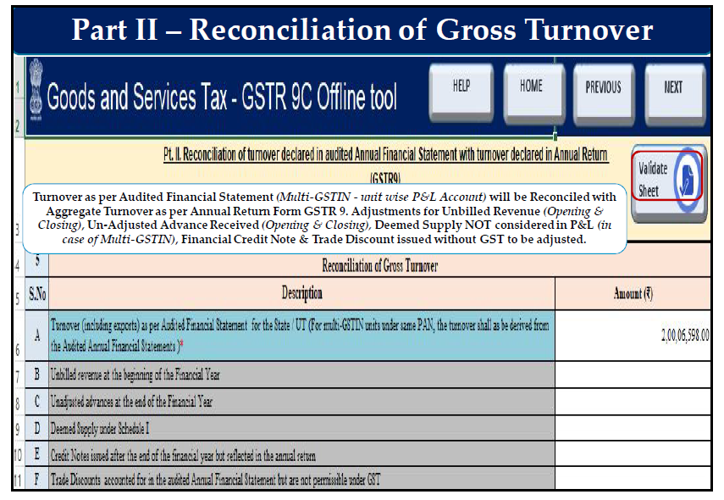

Slide 26
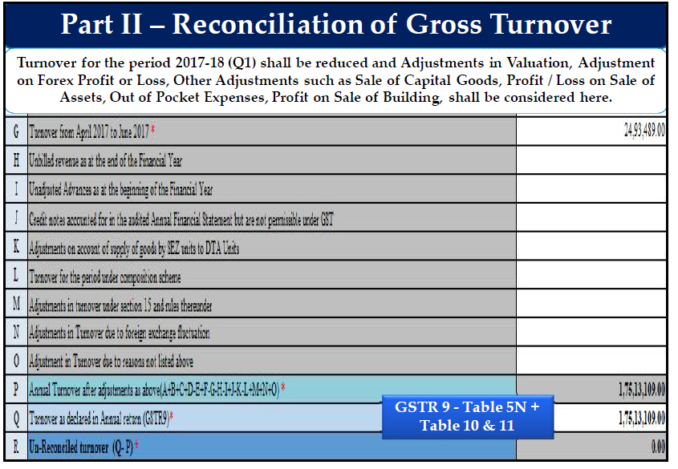

Slide 27
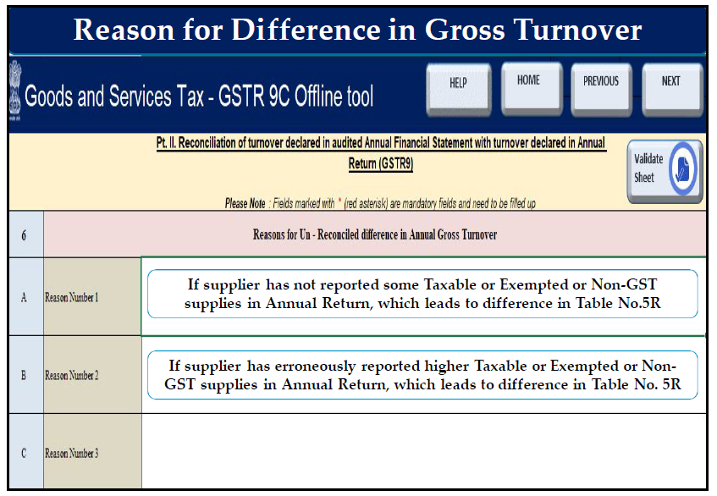

Slide 28
Reconciliation of taxable turnover :
[The table provides for reconciliation of taxable turnover from the audited annual turnover after adjustments with the taxable turnover declared in annual return GSTR-9]
7 | Reconciliation of taxable turnover
A | Annual turnover after adjustments (from 5P above) | <Auto>
 | Annual turnover as derived in Table 5P above would be auto-populated here.
B | Value of Exempted, Nil Rated, Non-GST supplies, No-Supply turnover
 | Value of exempted, nil rated, non-GST and no-supply turnover shall be declared here. This shall be reported net of credit notes, debit notes and amendments if any.
C | Zero rated supplies without payment of tax
 | Value of zero rated supplies (including supplies to SEZs) on which tax is not paid shall be declared here. This shall be reported net of credit notes, debit notes and amendments if any
Milk, water, educational and health services;
Non taxable supplies such as petrol, alcohol for human consumption;
No supplies like sale of land, betting and gambling.
If supplied by paying tax, such transaction not to be included.
Notes:
7b- no nil rated
7c. Only if made without payment of duty

Slide 29
Reconciliation of taxable turnover
D | Supplies on which tax is to be paid by the recipient on reverse charge basis.
 | Value of reverse charge supplies on which tax is to be paid by the recipient shall be declared here. This shall be reported net of credit notes, debit notes and amendments if any.
E | Taxable turnover as per adjustments above (A-B-C-D). | <Auto>
 | The taxable turnover is derived as the difference between the annual turnover after adjustments declared in Table 7A above and the sum of all supplies (exempted, non-GST, reverse charge etc.) declared in Table 7B, 7C and 7D above.
F | Taxable turnover as per liability declared in Annual Return (GSTR9).
 | Taxable turnover as declared in Table (4N – 4G) + (10-11) of the Annual Return (GSTR9) shall be declared here.
G | Unreconciled taxable turnover (F-E). | AT 2

Slide 30
Reconciliation of taxable turnover
8 | Reasons for Un - Reconciled difference in taxable turnover
 | Reasons for non-reconciliation between adjusted annual taxable turnover as derived from Table 7E above and the taxable turnover declared in Table 7F shall be specified here
A | Reason 1 | <<Text>>
B | Reason 2 | <<Text>>
C | Reason 3 | <<Text>>
Amounts shown in financials, but not in Return:
(a) Sales omitted in return;
(b) Fixed asset sales not shown in return;
(c) Turnover excess reported in return
(d) Duplication in turnover reported in return
(e) RCM inward supplies

Slide 31
GST.GOV.IN
OFF LINE TOOL SCREEN

Slide 32
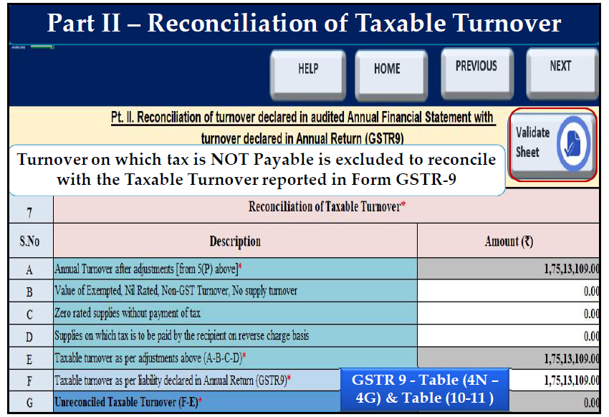

Slide 33
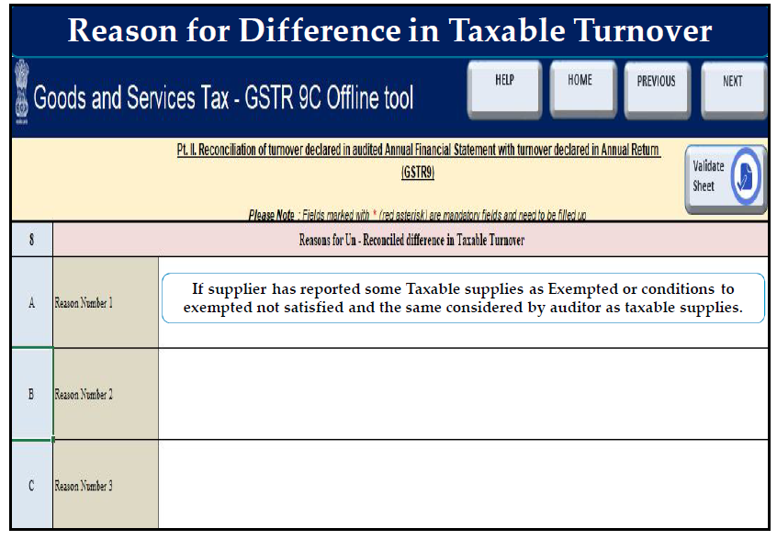

Slide 34
HIGHLIGHTS IN PART III - TABLE 9
HIGHLIGHTS
(1) Rate difference – Wrong application of Rate Notification;
(2) Concessional rate subject to conditions in Notification;
(3) RCM liability - tax amount billed by supplier and paid to him;
(4) Interest, penalty etc. remitted thru DRC-03;
(5) Remittance in different Major Account Head.
(6) Exempted goods and Services – Interpretation difference.
2

Slide 35
Part III - Reconciliation of tax paid
9 | Reconciliation of rate wise liability and amount payable thereon.
 | The table provides for reconciliation of tax paid as per reconciliation statement and amount of tax paid as declared in Annual Return (GSTR 9). Under the head labelled ―RC, supplies where tax was paid on reverse charge basis by the recipient (i.e. the person for whom reconciliation statement has been prepared ) shall be declared.
 | Description | Taxable Value | Central tax | State tax / UT tax | Integrated Tax | Cess, if applicable
 | 1 | 2 | 3 | 4 | 5 | 6
A | 5%
B | 5%(RC)
C | 12%
D | 12%(RC)

Slide 36
Reconciliation of tax paid
 | Description | Taxable Value | Central tax | State tax / UT tax | Integrated Tax | Cess, if applicable
 | 1 | 2 | 3 | 4 | 5 | 6
E | 18%
F | 18%(RC)
G | 28%
H | 28%(RC)
I | 3%
J | 0.25%
K | 0.10%

Slide 37
Reconciliation of tax paid
 | Description | Taxable Value | Central tax | State tax / UT tax | Integrated Tax | Cess, if applicable
 | 1 | 2 | 3 | 4 | 5 | 6
L | Interest
M | Late Fee
N | Penalty
O | Others
P | Total amount to be paid as per tables above |  | <Auto> | <Auto> | <Auto> | <Auto>
 | The total amount to be paid as per liability declared in Table 9A to 9O is auto populated here.

Slide 38
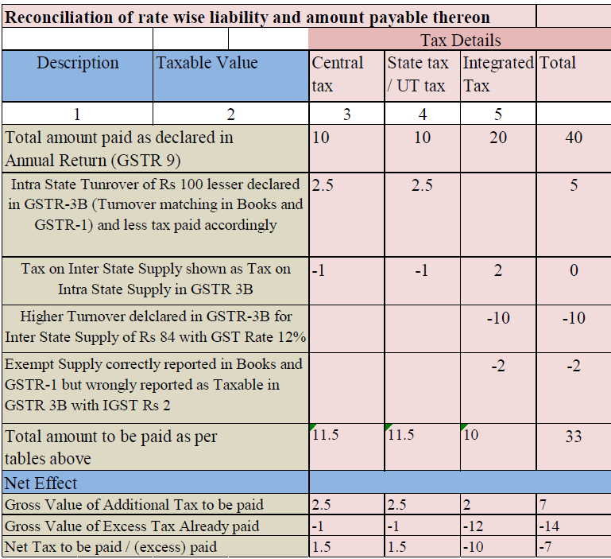
Reconciliation of tax paid
 | Description | Taxable Value | Central tax | State tax / UT tax | Integrated Tax | Cess, if applicable
 | 1 | 2 | 3 | 4 | 5 | 6
Q | Total amount paid as declared in Annual Return (GSTR 9)
 | The amount payable as declared in Table 9 of the Annual Return (GSTR9) shall be declared here. It should also contain any differential tax paid on Table 10 or 11 of the Annual Return (GSTR9).
R | Un-reconciled payment of amount |  |  |  | PT 1
10 | Reasons for un-reconciled payment of amount
 | Reasons for non-reconciliation between payable / liability declared in Table 9P above and the amount payable in Table 9Q shall be specified here
A | Reason 1 |  |  |  | <<Text>>
B | Reason 2 |  |  |  | <<Text>>
Amounts shown in financials, but not in Return:
(a) Sales omitted in return;
(b) Fixed asset sales not shown in return;
(c) Turnover excess reported in return
(d) Duplication in turnover reported in return
(e) Exempt supply wrongly reported as taxable supply
(f) 12% supply wrongly reported as 18% supply

Slide 39
GST.GOV.IN
OFF LINE TOOL SCREEN

Slide 40
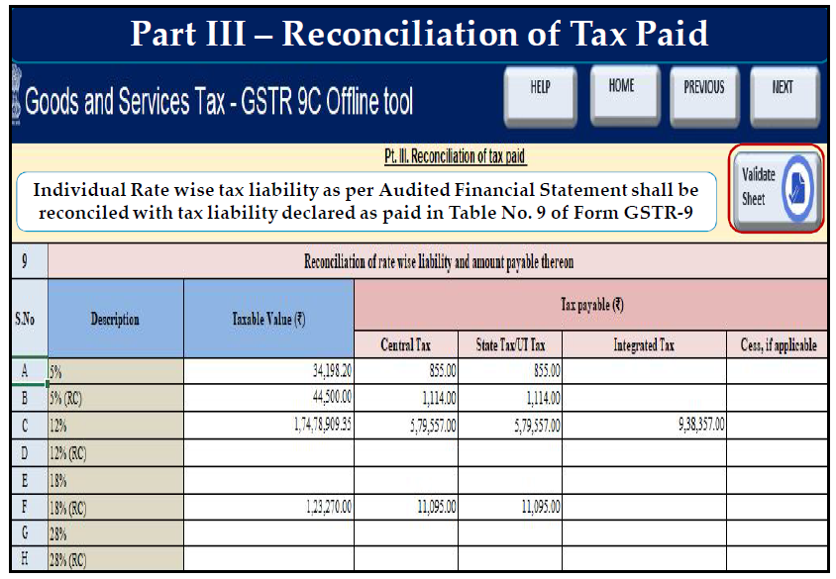

Slide 41
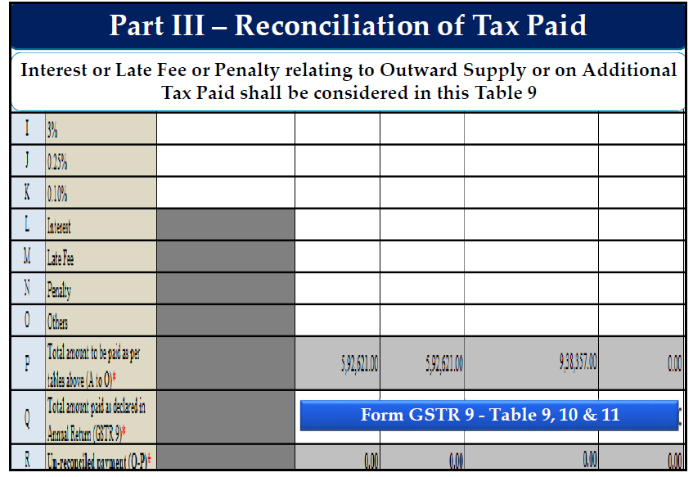

Slide 42
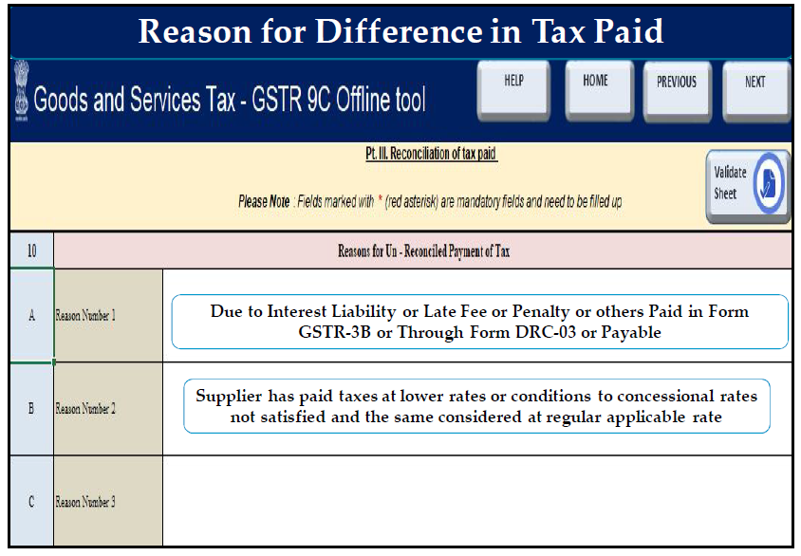

Slide 43
HIGHLIGHTS IN PART III - TABLE 9
HIGHLIGHTS
(1) Rate difference – Wrong application of Rate Notification;
(2) Concessional rate subject to conditions in Notification;
(3) RCM liability - tax amount billed by supplier and paid to him;
(4) Interest, penalty etc. remitted thru DRC-03;
(5) Remittance in different Major Account Head.
(6) Exempted goods and Services – Interpretation difference.
2

Slide 44
Additional amount payable
11 | Additional amount payable but not paid (due to reasons specified under Tables 6,8 and 10 above)
 | Any amount which is payable due to reasons specified under Table 6, 8 and 10 above shall be declared here.
 | Description | Taxable Value | Central tax | State tax / UT tax | Integrated Tax | Cess, if applicable
 | 1 | 2 | 3 | 4 | 5 | 6
 | 5%
 | 12%
 | 18%
 | 28%

Slide 45
Additional amount payable
11 | Additional amount payable but not paid (due to reasons specified under Tables 6,8 and 10 above)
 | Description | Taxable Value | Central tax | State tax / UT tax | Integrated Tax | Cess, if applicable
 | 3%
 | 0.25%
 | 0.10%
 | Interest
 | Late Fee
 | Penalty
 | Others (specify)

Slide 46
HIGHLIGHTS IN PART III - TABLE 11
HIGHLIGHTS
(1) Differential taxes identified in tables;
(2) Taxes not paid so far.
2

Slide 47
GST.GOV.IN
OFF LINE TOOL SCREEN

Slide 48
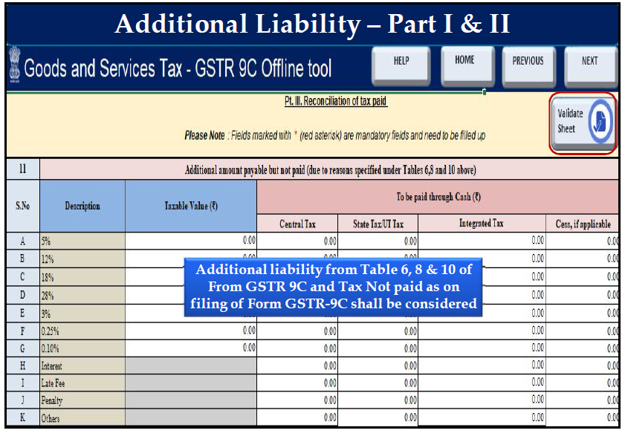

Slide 49
Reconciliation of Input Tax Credit
Part IV | Reconciliation of Input Tax Credit (ITC)
12 | Reconciliation of Net Input Tax Credit (ITC)
A | ITC availed as per audited Annual Financial Statement for the State/ UT (For multi-GSTIN units under same PAN, this should be derived from books of accounts).
 | ITC availed (after reversals) as per the audited Annual Financial Statement shall be declared here. There may be cases where multiple GSTINs (State-wise) registrations exist on the same PAN. This is common for persons / entities with presence over multiple States. Such persons / entities, will have to internally derive their ITC for each individual GSTIN and declare the same here. It may be noted that reference to audited Annual Financial Statement includes reference to books of accounts in case of persons / entities having presence over multiple States.
B | ITC booked in earlier Financial Years claimed in current Financial Year | (+)
 | Any ITC which was booked in the audited Annual Financial Statement of earlier financial year(s)but availed in the ITC ledger in the financial year for which the reconciliation statement is being filed for shall be declared here. This shall include transitional credit which was booked in earlier years but availed during Financial Year 2017-18.
Transitional credit of already taken credits will not come here but will come under 12A.

Slide 50
Reconciliation of Input Tax Credit
Part IV | Reconciliation of Input Tax Credit (ITC)
12 | Reconciliation of Net Input Tax Credit (ITC)
C | ITC booked in current Financial Year to be claimed in subsequent Financial Years. | (-)
 | Any ITC which has been booked in the audited Annual Financial Statement of the current financial year but the same has not been credited to the ITC ledger for the said financial year shall be declared here.
D | ITC availed as per audited financial statements or books of account. |  | <Auto>
 | ITC availed as per audited Annual Financial Statement or books of accounts as derived from values declared in Table 12A, 12B and 12C above will be auto-populated here.
E | ITC claimed in Annual Return (GSTR9).
 | Net ITC available for utilization as declared in Table 7J of Annual Return (GSTR9) shall be declared here.
TABLE 7J

Slide 51
Reconciliation of Input Tax Credit
Part IV | Reconciliation of Input Tax Credit (ITC)
F | Un-reconciled ITC |  | ITC-1
13 | Reasons for un-reconciled difference in ITC
 | Reasons for non-reconciliation of ITC as per audited Annual Financial Statement or books of account (Table 12D) and the net ITC (Table12E) availed in the Annual Return (GSTR9) shall be specified here
A | Reason 1 | <<Text>>
B | Reason 2 | <<Text>>
ITC claimed in next year;
Rule 42, 43 reversals not correctly given in GSTR 9;
ITC lapsed;
ITC on another GSTIN claimed in GSTR 9.

Slide 52
Reconciliation of Input Tax Credit
14 | Reconciliation of ITC declared in Annual Return (GSTR9) with ITC availed on expenses as per audited Annual Financial Statement or books of account.
 | This table is for reconciliation of ITC declared in the Annual Return (GSTR9) against the expenses booked in the audited Annual Financial Statement or books of account. The various sub-heads specified under this table are general expenses in the audited Annual Financial Statement or books of account on which ITC may or may not be available. Further, this is only an indicative list of heads under which expenses are generally booked. Taxpayers may add or delete any of these heads but all heads of expenses on which GST has been paid / was payable are to be declared here.
 | Description | Value | Amount of Total ITC | Amount of eligible ITC availed
 | (1) | (2) | (3) | (4)
A | Purchases
B | Freight / Carriage
C | Power and Fuel

Slide 53
Reconciliation of Input Tax Credit
14 | Reconciliation of ITC declared in Annual Return (GSTR9) with ITC availed on expenses as per audited Annual Financial Statement or books of account.
D | Imported goods (Including received from SEZs)
E | Rent and Insurance
F | Goods lost, stolen, destroyed, written off or disposed of by way of gift or free samples
G | Royalties
H | Employees' Cost (Salaries, wages, Bonus etc.)
I | Conveyance charges
J | Bank Charges
K | Entertainment charges
L | Stationery Expenses (including postage etc.)

Slide 54
Reconciliation of Input Tax Credit
14 | Reconciliation of ITC declared in Annual Return (GSTR9) with ITC availed on expenses as per audited Annual Financial Statement or books of account.
M | Repair and Maintenance
N | Other Miscellaneous expenses
O | Capital goods
P | Any other expense 1
Q | Any other expense 2
R | Total amount of eligible ITC availed |  |  | <<Auto>>
 | Total ITC declared in Table 14A to 14Q above shall be auto populated here.
Only eligible amounts to be include here;
The total of this clause in column 4 should be equal to 12A.

Slide 55
Reconciliation of Input Tax Credit
14 | Reconciliation of ITC declared in Annual Return (GSTR9) with ITC availed on expenses as per audited Annual Financial Statement or books of account.
S | ITC claimed in Annual Return (GSTR9)
 | Net ITC availed as declared in the Annual Return (GSTR9) shall be declared here. Table 7J of the Annual Return (GSTR9) may be used for filing this Table.
T | Un-reconciled ITC |  | ITC 2
15 | Reasons for un - reconciled difference in ITC
 | Reasons for non-reconciliation between ITC availed on the various expenses declared in Table 14R and ITC declared in Table 14S shall be specified here.
A | Reason 1 | <<Text>>
B | Reason 2 | <<Text>>
C | Reason 3 | <<Text>>
TABLE 7J
Ineligible ITC availed;
ITC in books availed in the next year.

Slide 56
Reconciliation of Input Tax Credit
16 | Tax payable on un-reconciled difference in ITC (due to reasons specified in 13 and 15 above)
 | Any amount which is payable due to reasons specified in Table 13 and 15 above shall be declared here.
 | Description | Amount Payable
 | Central Tax
 | State/UT Tax
 | Integrated Tax
 | Cess
 | Interest
 | Penalty

Slide 57
GST.GOV.IN
OFF LINE TOOL SCREEN

Slide 58
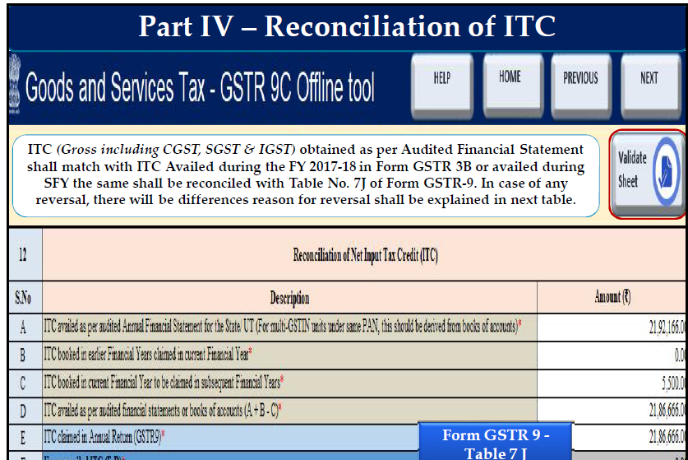

Slide 59
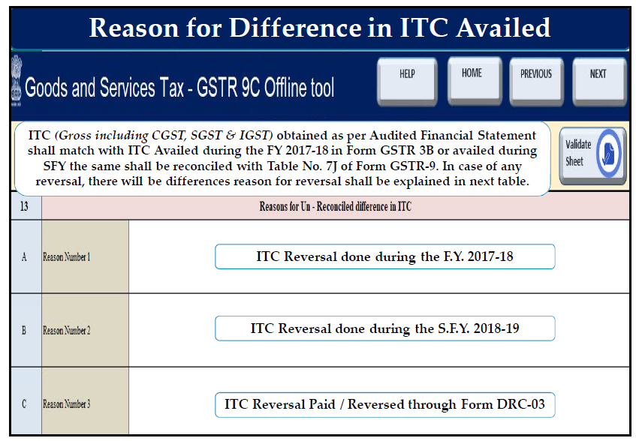

Slide 60
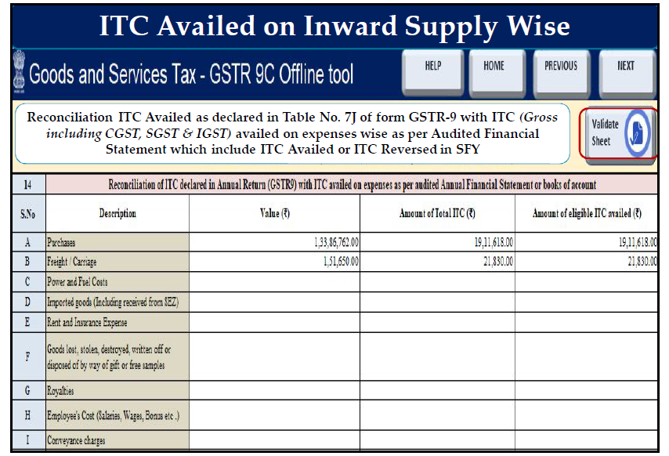

Slide 61
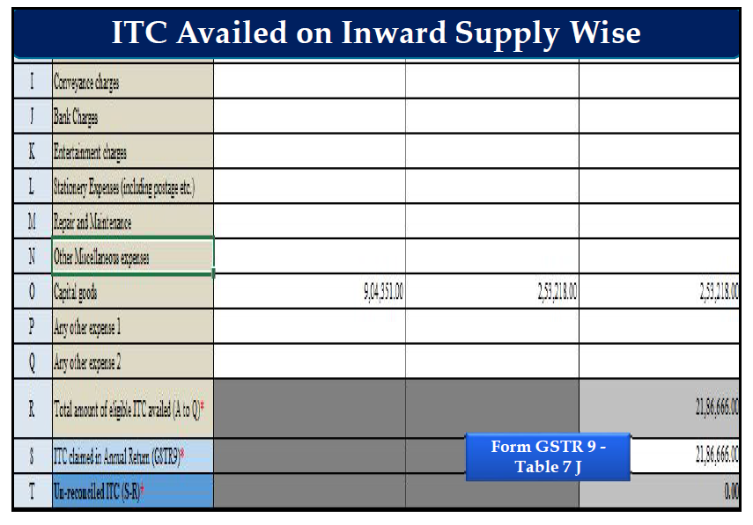

Slide 62
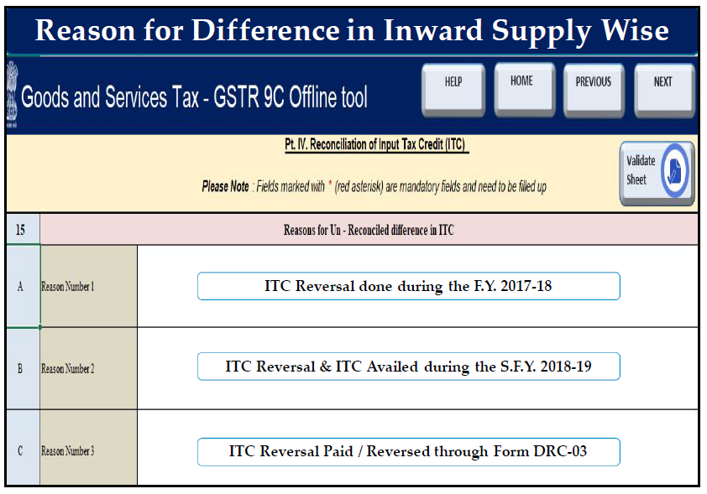

Slide 63
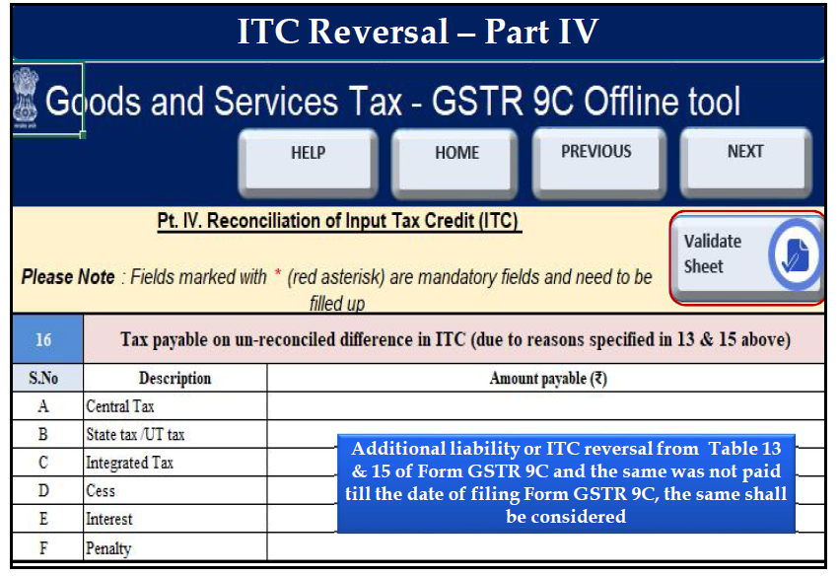

Slide 64
HIGHLIGHTS IN PART V
HIGHLIGHTS
(1) Deemed supplies – Schedule I – Not disclosed;
(2) Taxability on Advances – Change in Time of Supply provisions;
(3) RCM - Periodical additions;
(4) Ineligible credits and non-reversals;
(5) Rate of Interest as per Sec.50 Read with Sec 42(10) & Sec 43 (10)
2

Slide 65
Recommendation on additional liability
Part V | Auditor's recommendation on additional liability due to non-reconciliation
 | Part V consists of the auditor’s recommendation on the additional liability to be discharged by the taxpayer due to non-reconciliation of turnover or non-reconciliation of input tax credit. The auditor shall also recommend if there is any other amount to be paid for supplies not included in the Annual Return. Any refund which has been erroneously taken and shall be paid back to the Government shall also be declared in this table. Lastly, any other outstanding demands which is recommended to be settled by the auditor shall be declared in this Table
 |  |  | To be paid through Cash
 | Description | Value | Central tax | State tax / UT tax | Integrated tax | Cess, if applicable
 | (1) | (2) | (3) | (4) | (5) | (6)
 | 5%
 | 12%

Slide 66
Recommendation on additional liability
Part V | Auditor's recommendation on additional Liability due to non-reconciliation
 | Description | Value | Central tax | State tax / UT tax | Integrated tax | Cess, if applicable
 | 18%
 | 28%
 | 3%
 | 0.25%
 | 0.10%
 | Input Tax Credit
 | Interest
 | Late Fee

Slide 67
Recommendation on additional liability
Part V | Auditor's recommendation on additional Liability due to non-reconciliation
 | Description | Value | Central tax | State tax / UT tax | Integrated tax | Cess, if applicable
 | Penalty
 | Any other amount paid for supplies not included in Annual Return
 | Erroneous refund to be paid back
 | Outstanding demands to be settled
 | Other (Pl. specify)
Schedule I supplies not disclosed in GSTR 9
Advances received not disclosed in GSTR 9
All supplies which are not part of turnover and are missed out in GSTR 9

Slide 68
GST.GOV.IN
OFF LINE TOOL SCREEN

Slide 69
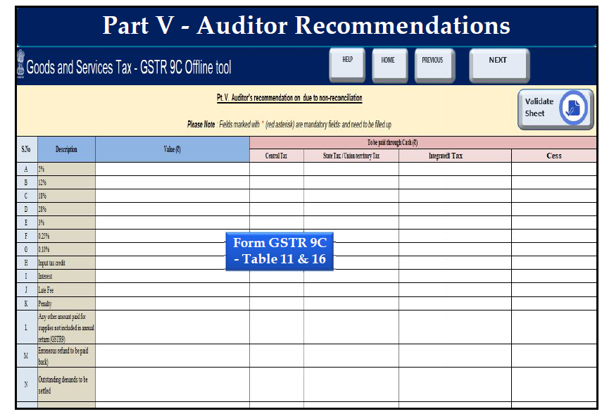

Slide 70
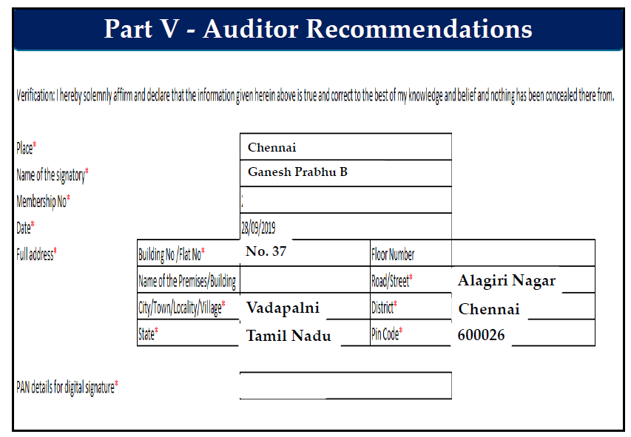

Slide 71
Verification of Registered Person
I hereby solemnly affirm and declare that I am uploading the reconciliation statement in FORM GSTR-9C prepared and duly signed by the Auditor and nothing has been tampered or altered by me in the statement. I am also uploading other statements, as applicable, including financial statement, profit and loss account and balance sheet etc.
Signature
Place :
Date :
Name of Authorized Signatory
Designation / status

Slide 72
PART B
CERTIFICATION

Slide 73
Form GSTR 9C
PART – B- CERTIFICATION
I. Certification in cases where the reconciliation statement (FORM GSTR-9C) is drawn up by the person who had conducted the audit:
I/we have examined the—
(a) balance sheet as on ………
(b) the profit and loss account/income and expenditure account for the period beginning from ………..…to ending on ……., and
(c) the cash flow statement for the period beginning from ……..…to ending on ………, attached herewith, of M/s …………… (Name), …………………….………… (Address), ..…………………(GSTIN).
2. Based on our audit I/we report that the said registered person—
has maintained the books of accounts, records and documents as required by the IGST/CGST/GST Act, 2017 and the rules/notifications made/issued thereunder;
.
Compliance with Sec 35 is mandatorily asked for.
Cash flow statement is mentioned. In case of non corporate persons, exception will have to be given.

Slide 74
has not maintained the following accounts/records/documents as required by the IGST/CGST/<<>>GST Act, 2017 and the rules/notifications made/issued thereunder:
1.
2.
3.
3. (a) I/we report the following observations/ comments / discrepancies / inconsistencies; if any:
…………………………………….
…………………………………….
3. (b) I/we further report that, -
(A) I/we have obtained all the information and explanations which, to the best of my/our knowledge and belief, were necessary for the purpose of the audit/ information and explanations which, to the best of my/our knowledge and belief, were necessary for the purpose of the audit were not provided/partially provided to us.

Slide 75
(B) In my/our opinion, proper books of account have/have not been kept by the registered person so far as appears from my/ our examination of the books.
(C) I/we certify that the balance sheet, the profit and loss/income and expenditure account and the cash flow Statement are in agreement/not in agreement with the books of account maintained at the Principal place of business at ……………………and ……………………additional place of business within the State.
4. The documents required to be furnished under section 35 (5) of the CGST Act and Reconciliation Statement required to be furnished under section 44(2) of the CGST Act is annexed herewith in Form No. GSTR-9C.
5. In my/our opinion and to the best of my/our information and according to explanations given to me/us, the particulars given in the said Form No.GSTR-9C are

Slide 76
are true and correct subject to following observations/qualifications, if any:
(a) ……………………………………………………………………………………
(b) ……………………………………………………………………………………
(c) ……………………………………………………………………………………
………………………………………
………………………………………
**(Signature and stamp/Seal of the Auditor)
Place: ……………
Name of the signatory …………………
Membership No………………
Date: ……………
Full address ……………………

Slide 77
Form GSTR 9C
PART – B- CERTIFICATION
II. Certification in cases where the reconciliation statement (FORM GSTR-9C) is drawn up by a person other than the person who had conducted the audit of the accounts:
I/we report that the audit of the books of accounts and the financial statements of M/s. ………...........…………………. (Name and address of the assessee with GSTIN) was conducted by M/s. …………………………………………..………. (full name and address of auditor along with status), bearing membership number in pursuance of the provisions of the …………………………….Act, and I/we annex hereto a copy of their audit report dated ……………………………. along with a copy of each of :-
(a) balance sheet as on ………
(b) the profit and loss account/income and expenditure account for the period beginning from ………..…to ending on …….,

Slide 78
(c) the cash flow statement for the period beginning from ……..…to ending on ………, and
(d) documents declared by the said Act to be part of, or annexed to, the profit and loss account/income and expenditure account and balance sheet.
2. I/we report that the said registered person—
has maintained the books of accounts, records and documents as required by the IGST/CGST/<<>>GST Act, 2017 and the rules/notifications made/issued thereunder
has not maintained the following accounts/records/documents as required by the IGST/CGST/<<>>GST Act, 2017 and the rules/notifications made/issued thereunder:
1.
2.
3.

Slide 79
3. The documents required to be furnished under section 35 (5) of the CGST Act and Reconciliation Statement required to be furnished under section 44(2) of the CGST Act is annexed herewith in Form No.GSTR-9C.
4. In my/our opinion and to the best of my/our information and according to examination of books of account including other relevant documents and explanations given to me/us, the particulars given in the said Form No.9C are true and correct subject to the following observations/qualifications, if any
(a) …………………………….…………………………….………………………
(b) …………………………….…………………………….………………………
(c) …………………………….…………………………….………………………
(Signature and stamp/Seal of the Auditor)
Place: ……………
Name of the signatory …………………
Membership No………………
Date: ……………
Full address ……………………
True and fair view is not the objective
Reconciliation is to be certified.
Start point and end point are not certified. No determination of turnover as in the case of VAT reports

Slide 80


Thank You
Visit: www. idtc.icai. org
For any clarification, please contact:
The Study Group on GST – Kerala
Email : ca.somannl@gmail.com
Mobile : 98951 38780
CA. Soman N L, M.Com; FCA.

